Slide 1
Lecture
Intellectual property in the digital era

Slide 2
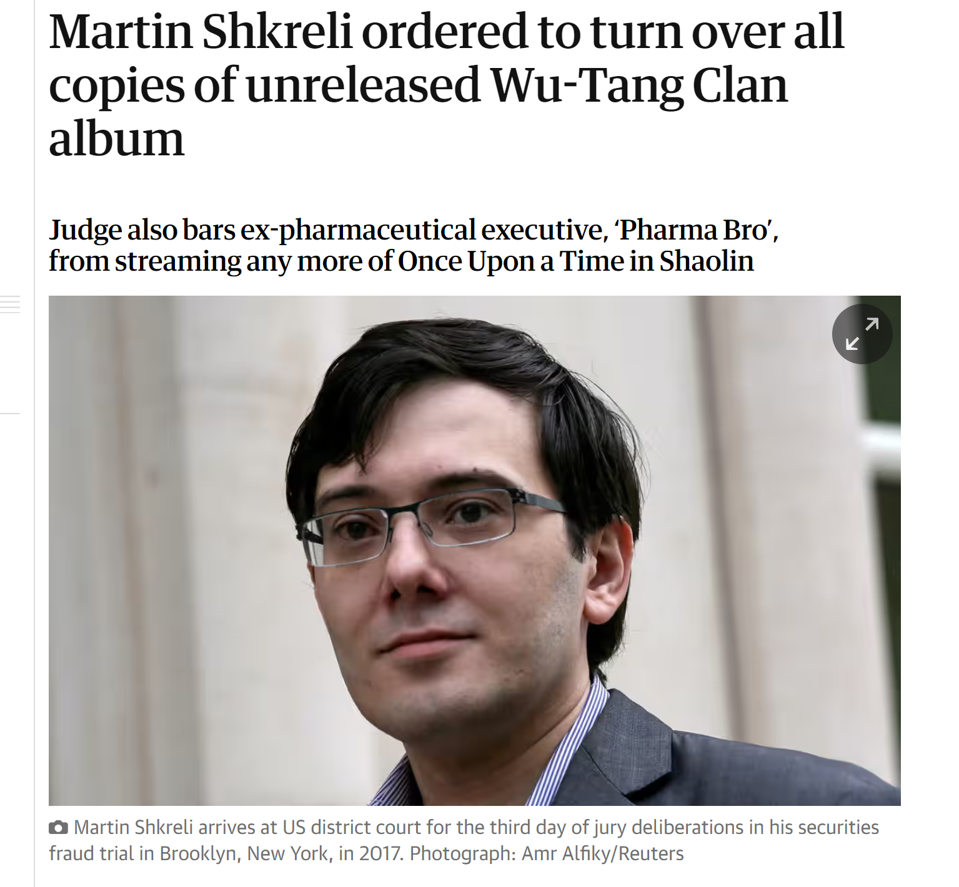
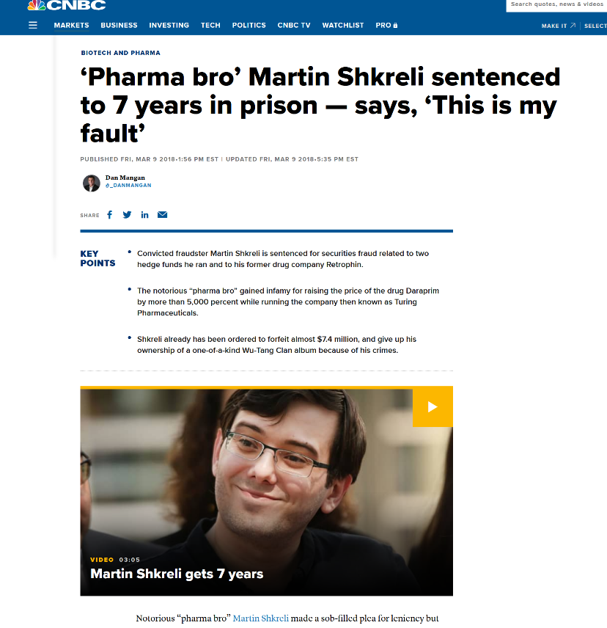
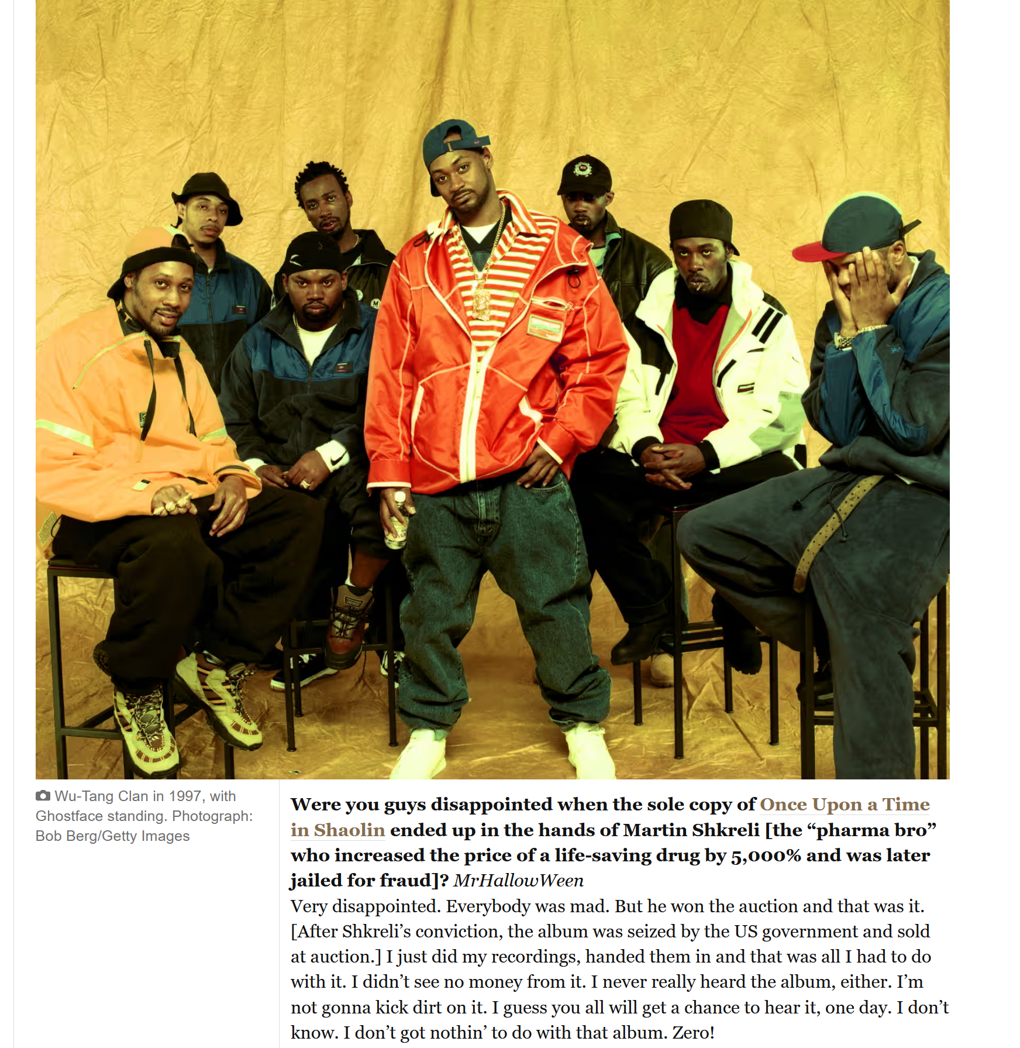
Introduction 1/2
Title: Presentation
Subtitle field

Slide 3
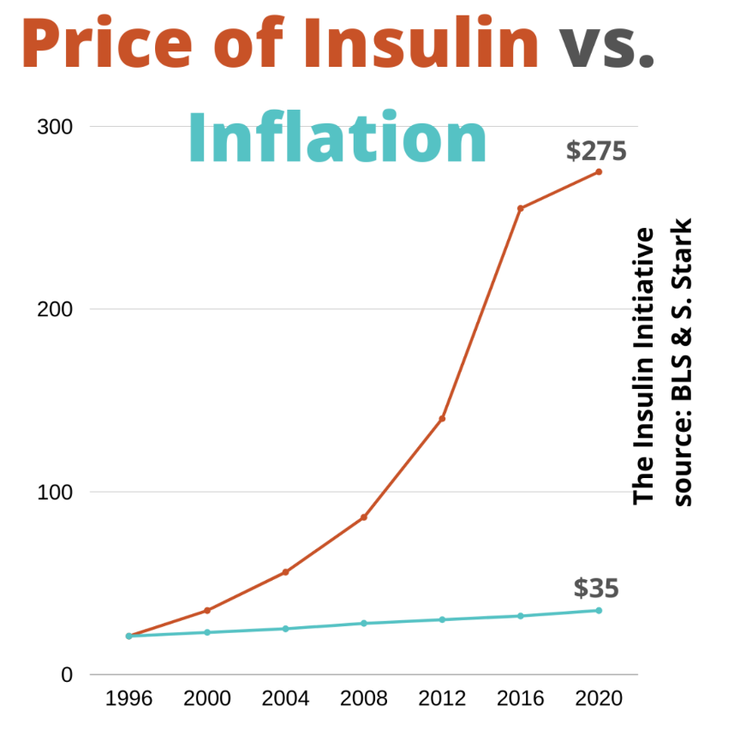
Introduction 2/2
Title: Presentation
Subtitle field

Slide 4
What is intellectual property (IP)
Title: Presentation
Subtitle field
Definition: Intellectual property is the tangible and intangible products of the human mind.
Physical property is either made or purchased.
Intellectual property is the results of one’s ideas.
Requires a creative effort <> Machine generated
Art, music, books, poetry, Software, blueprint
Value comes from both the physical medium (ink, paper, vinyl, aluminum, etc) and the work needed to produce the content.
Price reflects both the medium and the content.
Examples of IP: patent, copyright, trade secret

Slide 5
patents
Title: Presentation
Subtitle field
Technical inventions
Patentability ( software, business plans, algorithms, gene therapy , …)
Ethical issues
3 criteria: novelty, non-obvious, commercial use
Limited protection in time vs. Knowledge disclosure
<> secret
Problems: patent thicket and wording, blocking patents, patent pools and essential patents, trolls, FRAND

Slide 6
Patent wars: patents as swords
Title: Presentation
Subtitle field
IP strategy
$20 billion on patent litigation and patent purchases 2010+2011 in smartphone industry
« Last year, for the first time, spending by Apple and Google on patent lawsuits and unusually big-dollar patent purchases exceeded spending on research and development of new products, according to public filings.”

Slide 7
What is protected?
Title: Presentation
Subtitle field
Protects software (in the United States)
Protects business models and certain scientific formulae
Theoretically, more protection = more incentives and more innovation, but less use (see below)
The incredible increase in the number of patents in recent years reflects this trend

Slide 8
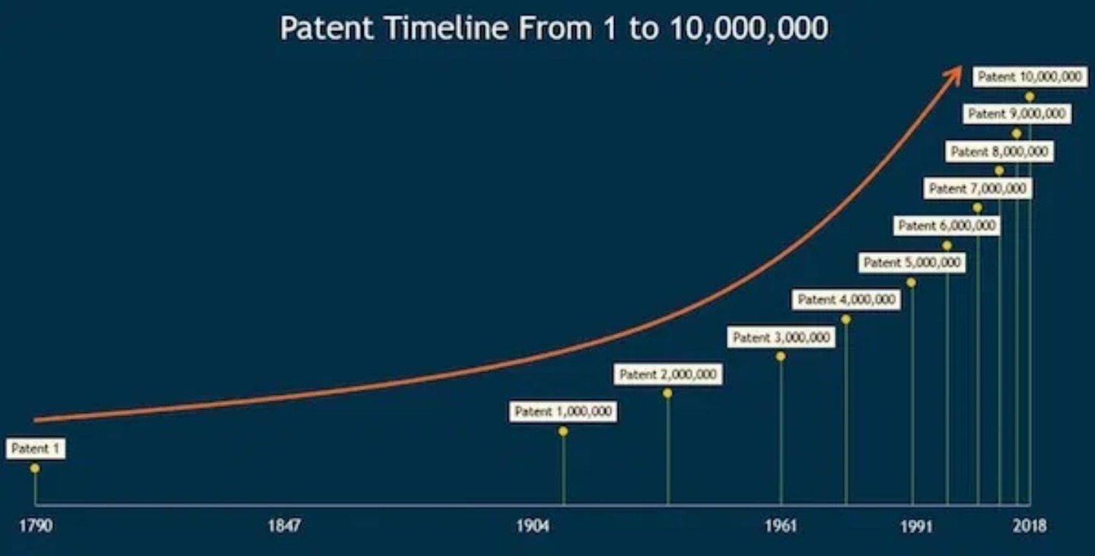
Number of patents in the US
Title: Presentation
Subtitle field

Slide 9
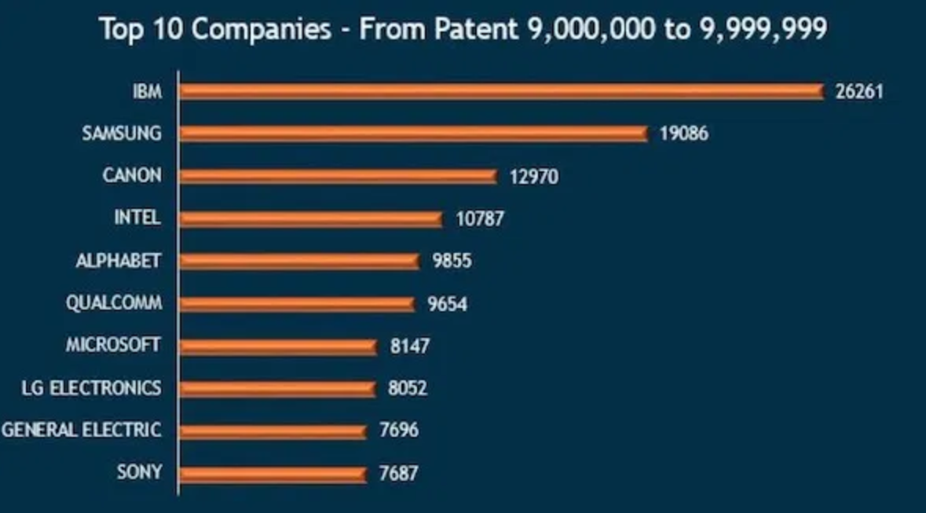
Type of companies
Title: Presentation
Subtitle field

Slide 10
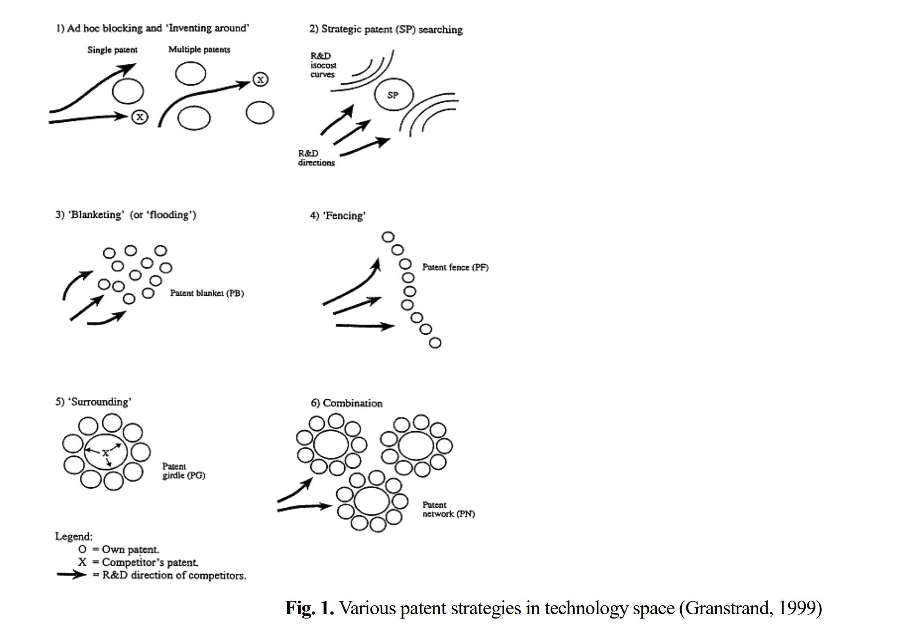
Patent strategies
Title: Presentation
Subtitle field
Protection
Bargaining
Improving corporate image
Attracting external funds
Internal reasons (motivating researchers, R&D metric)

Slide 11
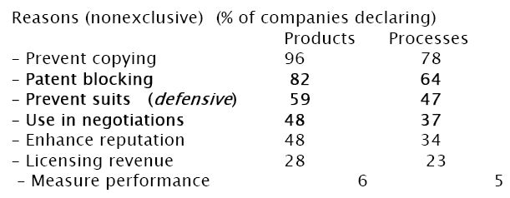
Patent strategies (cont.)
Title: Presentation
Subtitle field
Source: Cohen et al. (2000)

Slide 12
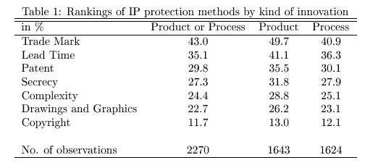
Patent strategies (cont.)
Title: Presentation
Subtitle field

Slide 13
Best Understanding patent litigations
Title: Presentation
Subtitle field
Rational ignorance
Lemley
Vs. European Patent Office

Slide 14
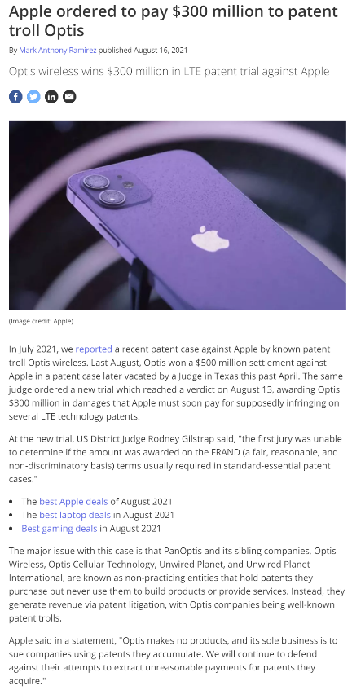
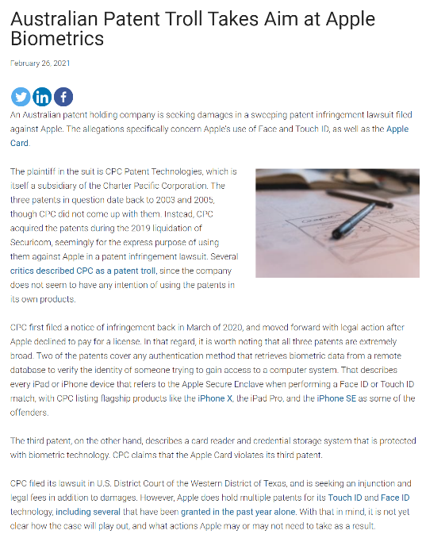
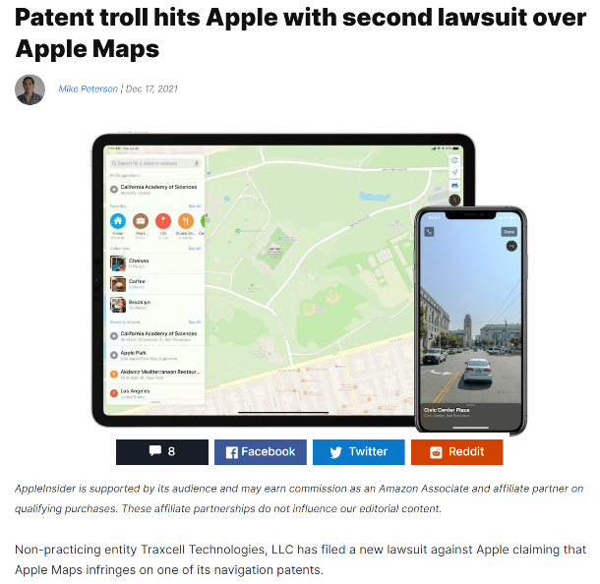
Patent trolls
Title: Presentation
Subtitle field

Slide 15
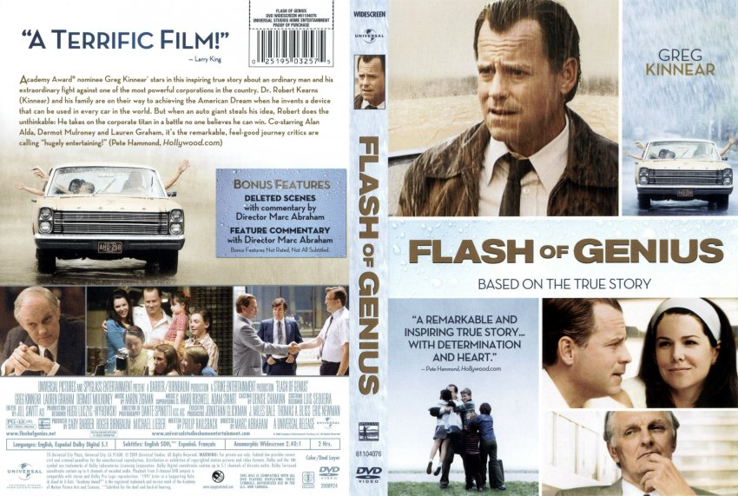
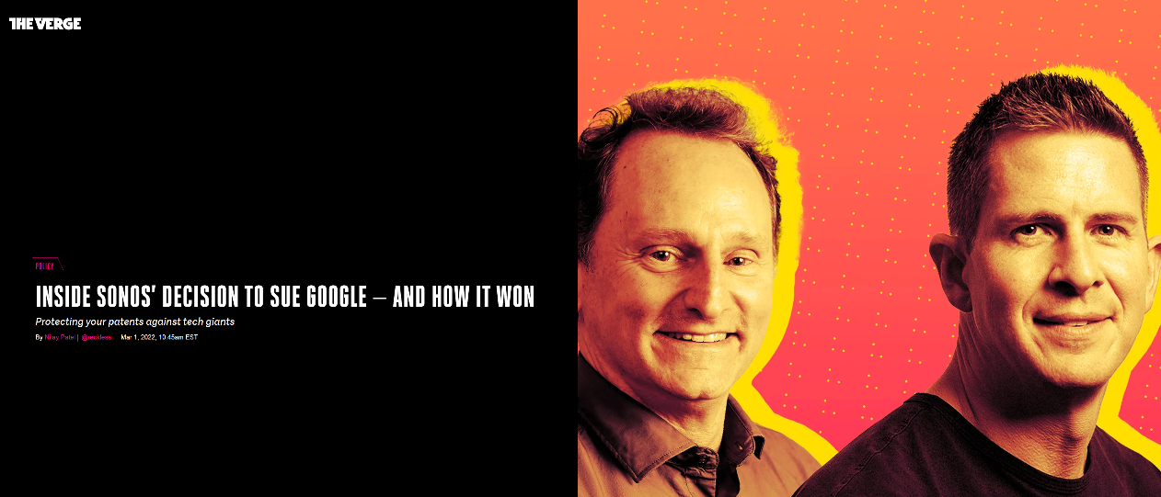
Unlawful appropriation
Title: Presentation
Subtitle field

Slide 16
Patent vs. secrecy
Title: Presentation
Subtitle field
Intentional efforts needed for secrecy
Example: Coca-Cola formula (2 persons?)
Discuss pros and cons
Patents
Secrecy

Slide 17
Copyright
Title: Presentation
Subtitle field
Lecture 2: strategies assumed no piracy or perfect copyright protection
Today: with the internet, more difficult to prevent end-user copying of digital goods
Example: Peer-to-peer or file-sharing networks (Napster, Kazaa, Emule, BitTorrent, …)
End-user piracy ≠ for-profit or commercial piracy
Commercial piracy: should be limited; negative effect; no controversy
What are the economic implications of end-user piracy?

Slide 18
Copyright: definition
Title: Presentation
Subtitle field
Copyright exists to give creators of ‘artistic’ works the ability to generate revenues.
The theory is that without copyright, competition in selling reproductions of a title would drive the price down to the marginal cost of producing a reproduction.
They are given monopoly protection, which increases their revenues, but raises price to consumers.
The exclusivity created by copyright or patents is limited in length and in breadth.
This increases the number of inventions, but decreases the use of each invention

Slide 19
Copyright length
Title: Presentation
Subtitle field
Life of the author plus 70 years
‘Work for hire’, movies, games?, 95 years.
Is this too long?
Creative commons members say ‘yes.’
17 economists say ‘yes.’
Mark Twain says `no’
Complicated issue:
Originally 14+14 years; then 28 +14; then max{75, death+50); then max {95, death+70}

Slide 20
Copyright lenght (cont.)
Title: Presentation
Subtitle field

Slide 21
copyright act Extensions
Title: Presentation
Subtitle field
1790 -Books, maps and charts
1802 -Prints
1831 -Music
1865 -Photographs
1870 -Drama, paintings, drawings and sculpture
1912 -Movies
1964, 1976 -Computer Programs
1971 -Records and tapes
1976 -Dance
1990 -Architecture
1998 -Mickey Mouse Act

Slide 22
1998 - Digital Millenium copyright act
Title: Presentation
Subtitle field
Digital world is identical to the physical world
Makes it a crime to circumvent measures that control access to copyrighted works (DRM)
Exemption from direct and indirect liability of Internet service providers and other intermediaries

Slide 23
limitations
Title: Presentation
Subtitle field
Non-profit musical performances
Radio musical performance in restaurants and small businesses (1976)
Works of utility (a chair)
Expressions of fact (phone book)
Ideas vs. expression of ideas
Fair use
Parody and commentary

Slide 24
Fair use
Title: Presentation
Subtitle field
There is in the law an attempt to balance the interests of copyright holders and those of users.
Fair use is a defense to a claim of copyright infringement. It allows copying in instances when the copying appears not to be hurting the copyright owners revenues.
Betamax Case said home videotaping was fair use, and thus home videotaping was allowed.

Slide 25
Fair use: 4 factors
Title: Presentation
Subtitle field
Amount of the copyright product that is copied.
Nature of the Copyright product (commercial versus academic or scholarly.
Nature of the use of the copied product
Impact on the revenues of the copyright holder.
Last factor is the most important.
The economic rationale for ‘fair use’ is that it increases the welfare of the consumer without seriously reducing the welfare of the producer and it saves on transaction costs of negotiating with copyright holder.

Slide 26
Fair use and internet file-sharing
Title: Presentation
Subtitle field
Is internet file-sharing fair use?
Judges say no: prevented the development of legal market for digital music
More generally, what is the impact of file-sharing on firm profits?
Legal responses:
Lawsuits against individual users
Why?
Institutional response:
HADOPI/ARCOM 3-strike/graduated response

Slide 27
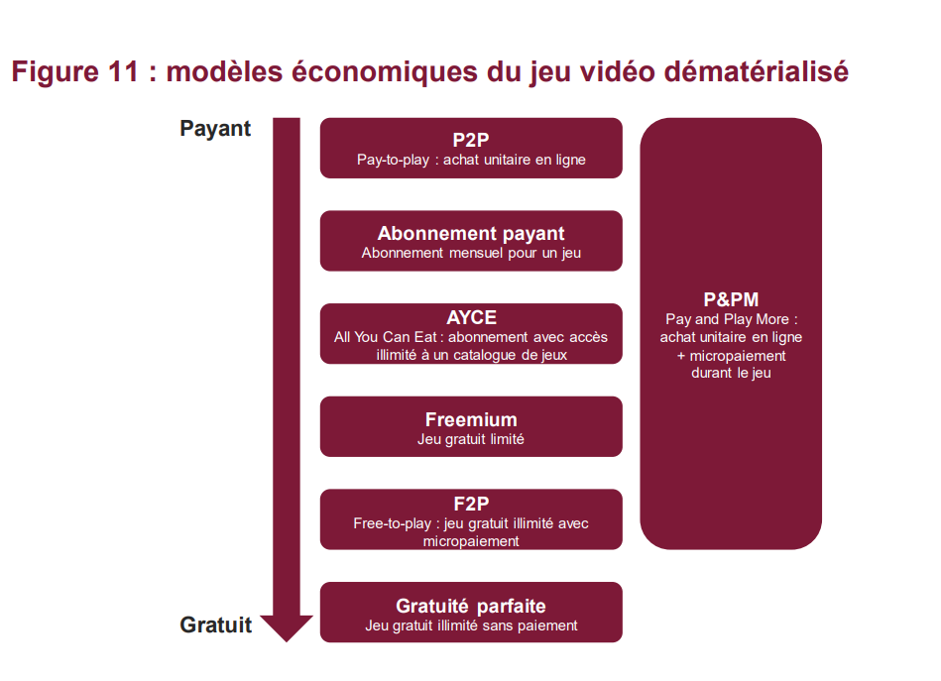
ImpACt of digitization: new business models
Title: Presentation
Subtitle field

Slide 28
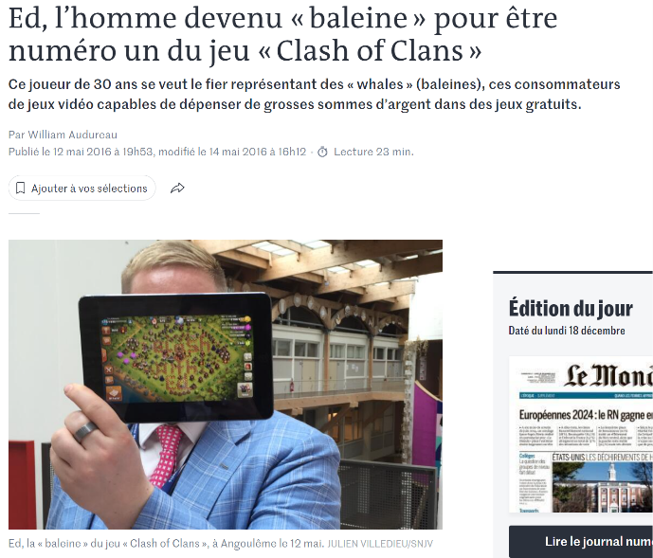
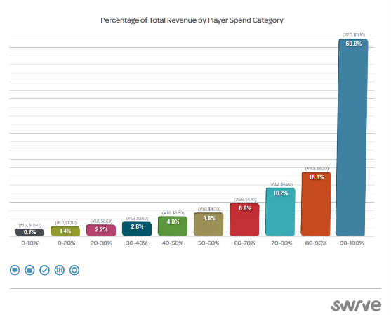
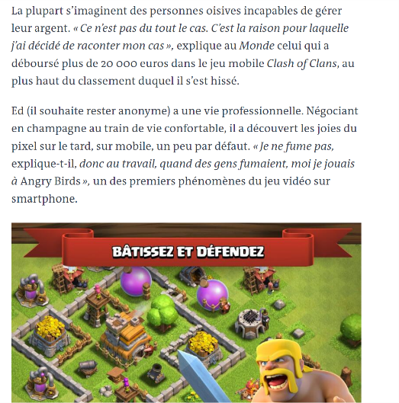
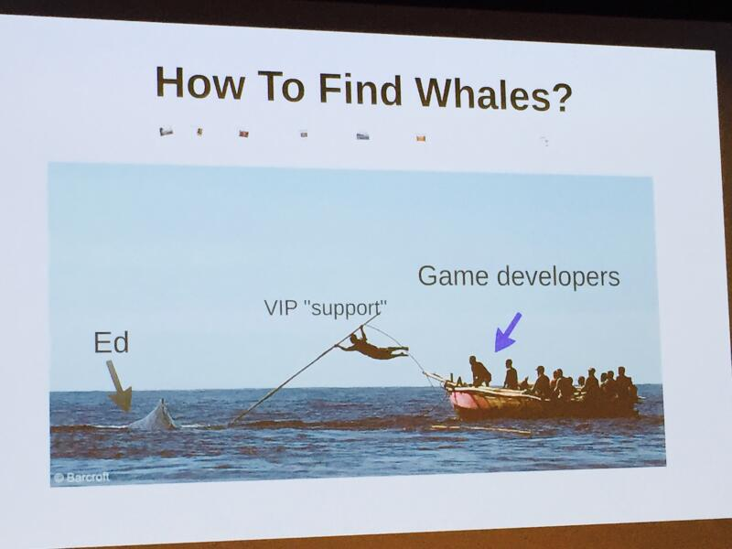
ImpACt of digitization: Monetize user base
Title: Presentation
Subtitle field

Slide 29
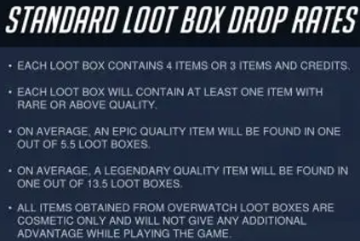
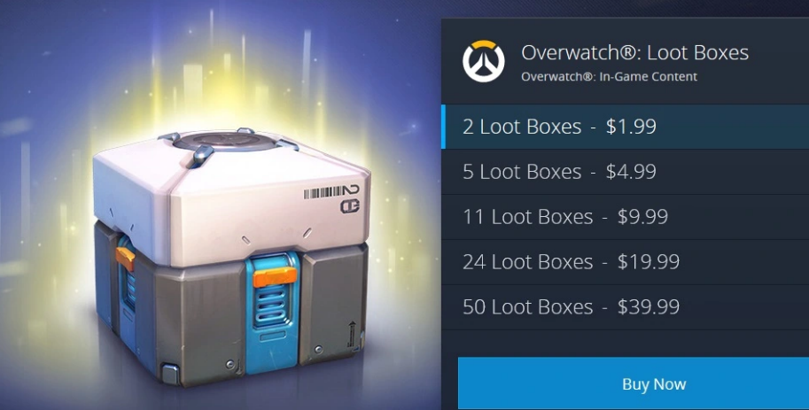
ImpACt of digitization: Loot boxes
Title: Presentation
Subtitle field

Slide 30
Impact of digitization: from property to rental
Title: Presentation
Subtitle field
New issues
Digital Rights Management
Privacy: « the book that reads you »
Issues for both free and paid versions
Uncertainty about property rights -> Lemons
Sovereignty
Heritage
Autonomy : « we are all being programmed »

Slide 31
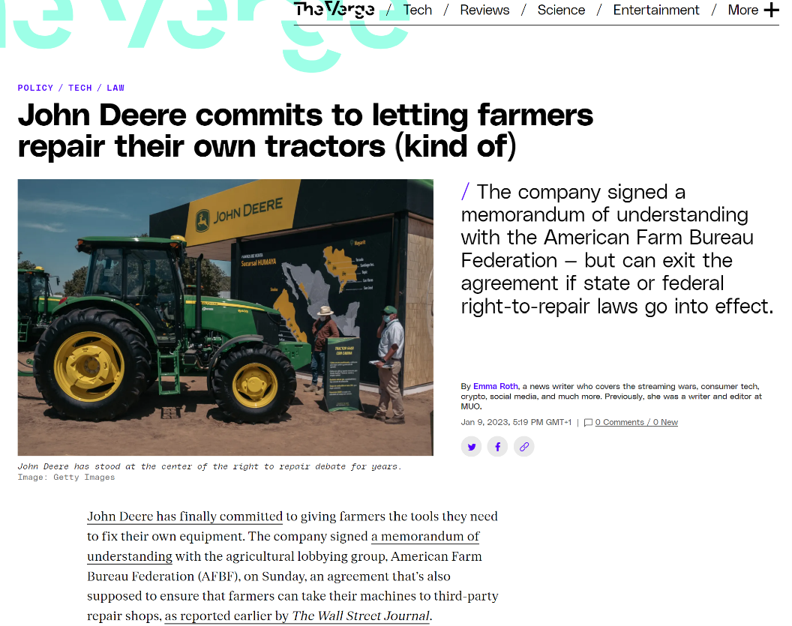
ImpACt of digitization: Sustainability
Title: Presentation
Subtitle field

Slide 32
Impact of digitization: exhaustion principle
Title: Presentation
Subtitle field
Control the transfer of property rights
Including : First Sale doctrine against the control of the copyright owner

Slide 33
IPR Basic trade-off
Title: Presentation
Subtitle field
Incentive problem within the relationship between one principal (society) and one agent (potential innovator) in order to produce a public good (knowledge, music, writings, films, …).
Induce innovation if social expected value exceeds social expected cost. If so, create sufficient incentives for the innovator so that private expected compensation exceeds private expected costs.
IP must be particularly protected when
creation process is costly (either financially or in terms of opportunity costs);
research is risky (the probability of innovation is low).

Slide 34
Economic rationale of IP rights
Title: Presentation
Subtitle field
Non-excludability means no sales, and no sales might mean no production
risk of underproduction
Law awards exclusive right to control the production and the sales of their goods.
Generates an underutilization problem:
Monopoly: price > marginal cost (= zero); consumers who are willing to pay more than zero but less than monopoly price don’t consume; inefficiency
IP laws strike a balance between the two conflicting problems: the exclusivity created by copyright or patents is limited in length and in breadth; second best solution

Slide 35
Basic trade-off
Title: Presentation
Subtitle field
Incentives:
Dynamic efficiency
Infinitie protection
Use:
Static efficiency
No protection

Slide 36
Title
Subtitle

